Slide 1
REAL-ESTATE PRICE PREDICTION
using Advanced Regression Analysis
Done by :
Yuva Daranee P & Ashwin Kumar A

Slide 2
Problem Statement
To make the comparison easier for the buyers in the prediction of prices of house.
To the make the jobs of real-estate agents easier.
For the reduction of biased prices and crimes.
To make a platform that is easier to use for any segment of users

Slide 3
Abstract
The goal is to predict the final Sale Price of the houses in the test data set.
Housing price is strongly based on factors such as location, features and facilities available.
The performances of various regression techniques such as Random Forest, Stochastic Gradient Descent, Gradient Boosting, and Xtremme Gradient Boosting are compared.
Then the best fit model is chosen for achieving maximum accuracy.
This project explores the Housing dataset from Kaggle.
The dataset contains 79 variables describing various aspects of residential homes in Ames, Iowa.

Slide 4
Introduction
House Price Index (HPI) is commonly used to estimate the changes in housing price.
Housing price is strongly correlated to other factors such as location, area, population.
Traditional machine learning approaches to predict housing prices are accurate, but they rarely concern about the performance of individual models.
This paper will apply both traditional and advanced machine learning approaches to investigate the difference among several advanced models.
Multiple techniques are used in model implementation on regression and provide an optimistic result for housing price prediction.

Slide 5
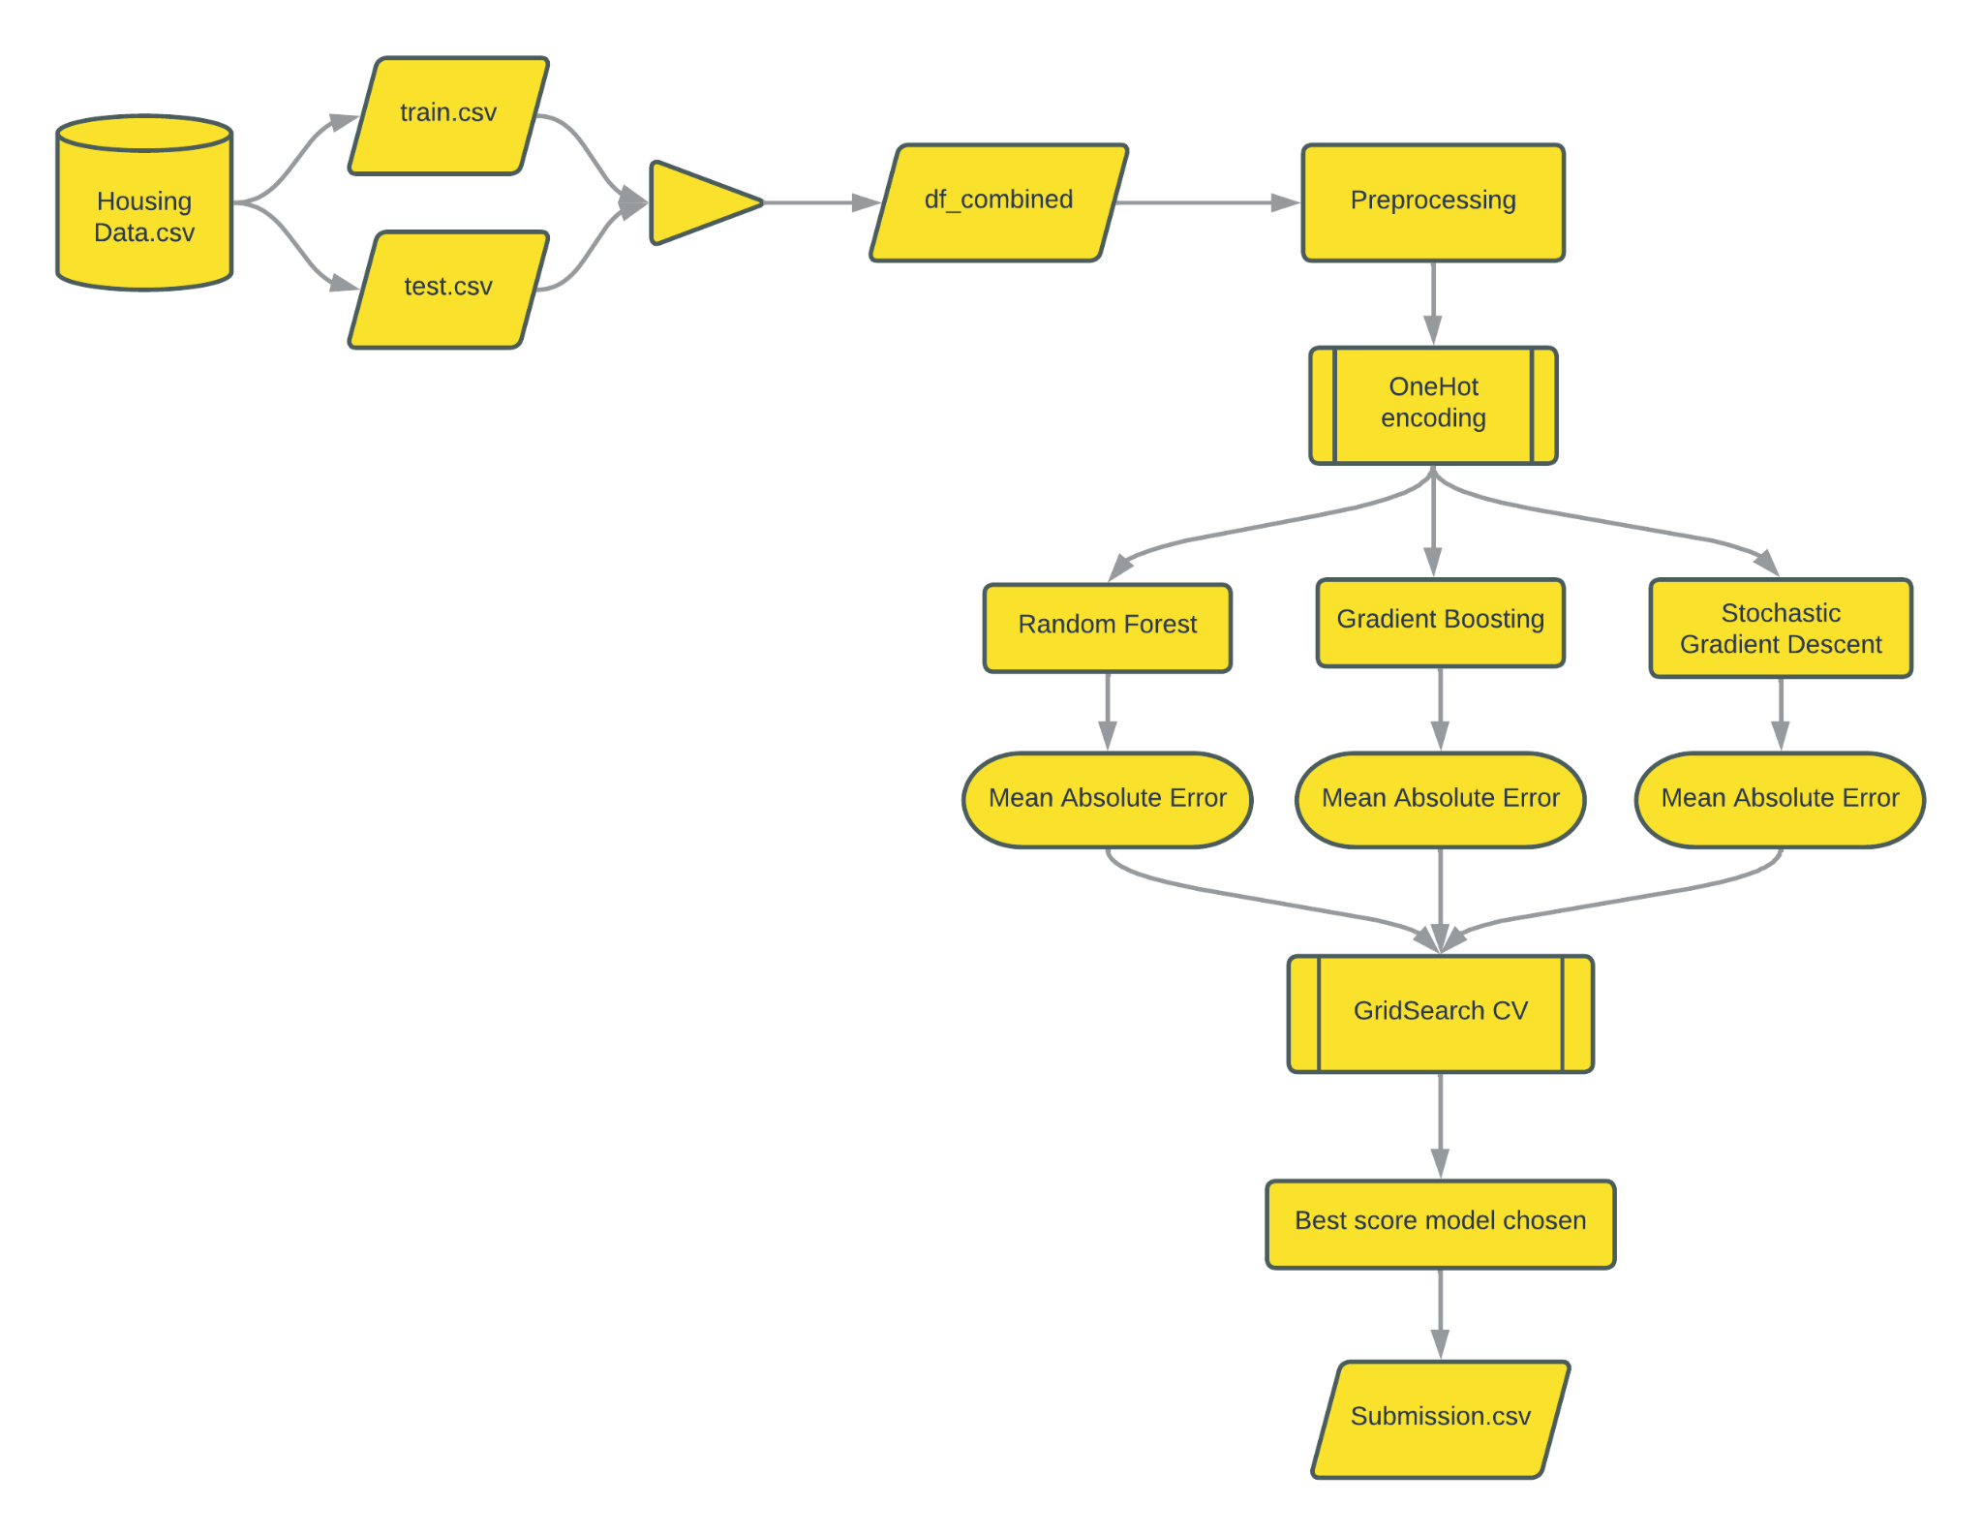
System Architecture

Slide 6
Algorithms used :
The models used here are :
Random Forest
Gradient Boosting
Stochastic Gradient Descent
and we use GridSearch CV for finding the best model that outperforms the other two in the specified parameters.

Slide 7
Technology used
Domain : Machine Learning
Language : Python 3.10.8
Platform : Google Colab
Techstack : (Packages used ):
Pandas – reading and accessing Database
NumPy – for calculations with arrays and matrices
Matplotlib.pyplot – for data visualization
Seaborn – to visualize random distributions
Sklearn – for model and parameter tuning

Slide 8
System Requirements
Processor : i5 10th gen or above
Memory : 8Gb minimum
Storage : 5Gb of free space
Platform : Google colab or Jupyter notebook

Slide 9
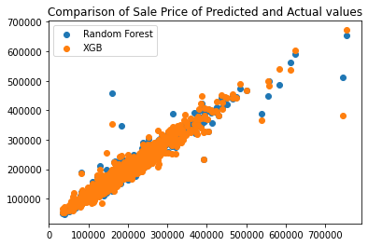
Output
fig(a): The comparison of the outputs produced by XGB, Random Forest and SGD

Slide 10
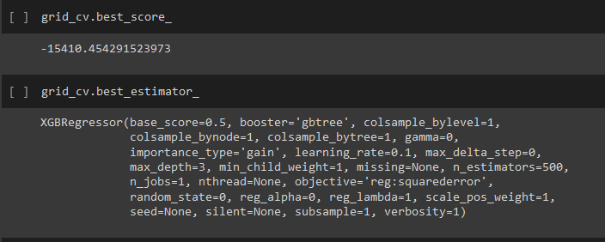
Output
fig(b): GridSearch CV finding the model with the best score for the provided parameters and using it to obtain the desired results with higher optimality.

Slide 11
Pros & Cons
Advantages:
Easier to implement, interpret and efficient to train
It handles overfitting pretty well using dimensionally reduction techniques, regularization, and cross-validation
Disadvantages:
Regression models does not work properly if the data has errors or if the missing values are not handled.
If there exists a strong linear correlation between the independent variables, they will eat into each other’s predictive power

Slide 12
Scope
House price forecasting is a tool that plays a major role in the field of real estate.
Useful for house buyers and sellers since many people didn’t have awareness of fixing prices by comparing the surroundings.
House Price prediction model is very essential in filling the information gap and improve Real Estate efficiency.
With this model, we would be able to better predict the prices.

Slide 13
Conclusion
The model executed successfully to produce the desired result using a multi-model best fit approach.
Using with accuracy score of 0.13472.

